Slide 1

Sprint – 2
Identify database for our requirements

Slide 2
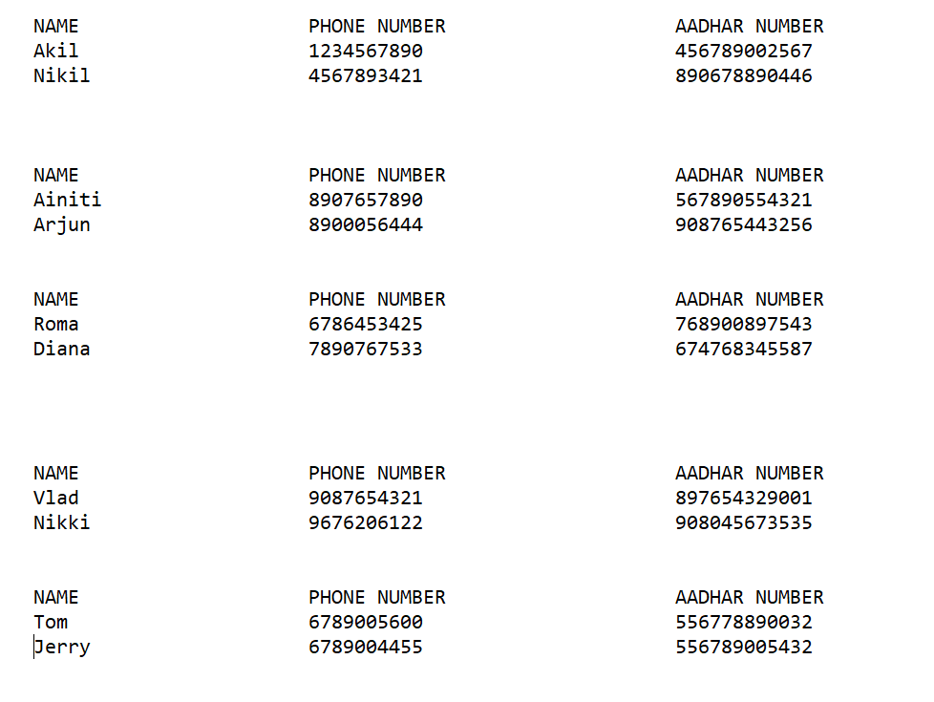
Creating a flat file with the given details

Slide 3
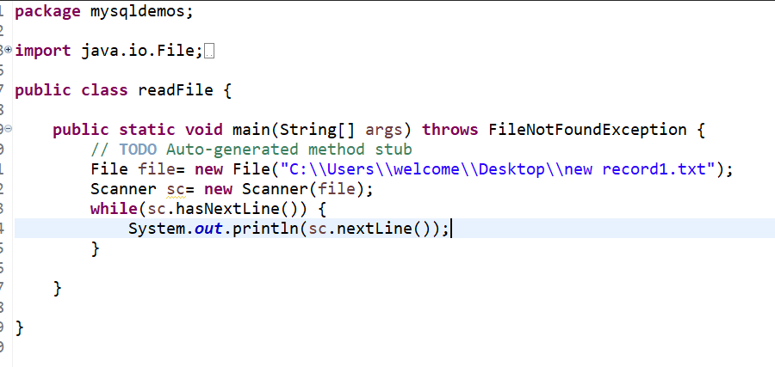
Reading Data from Flat File

Slide 4
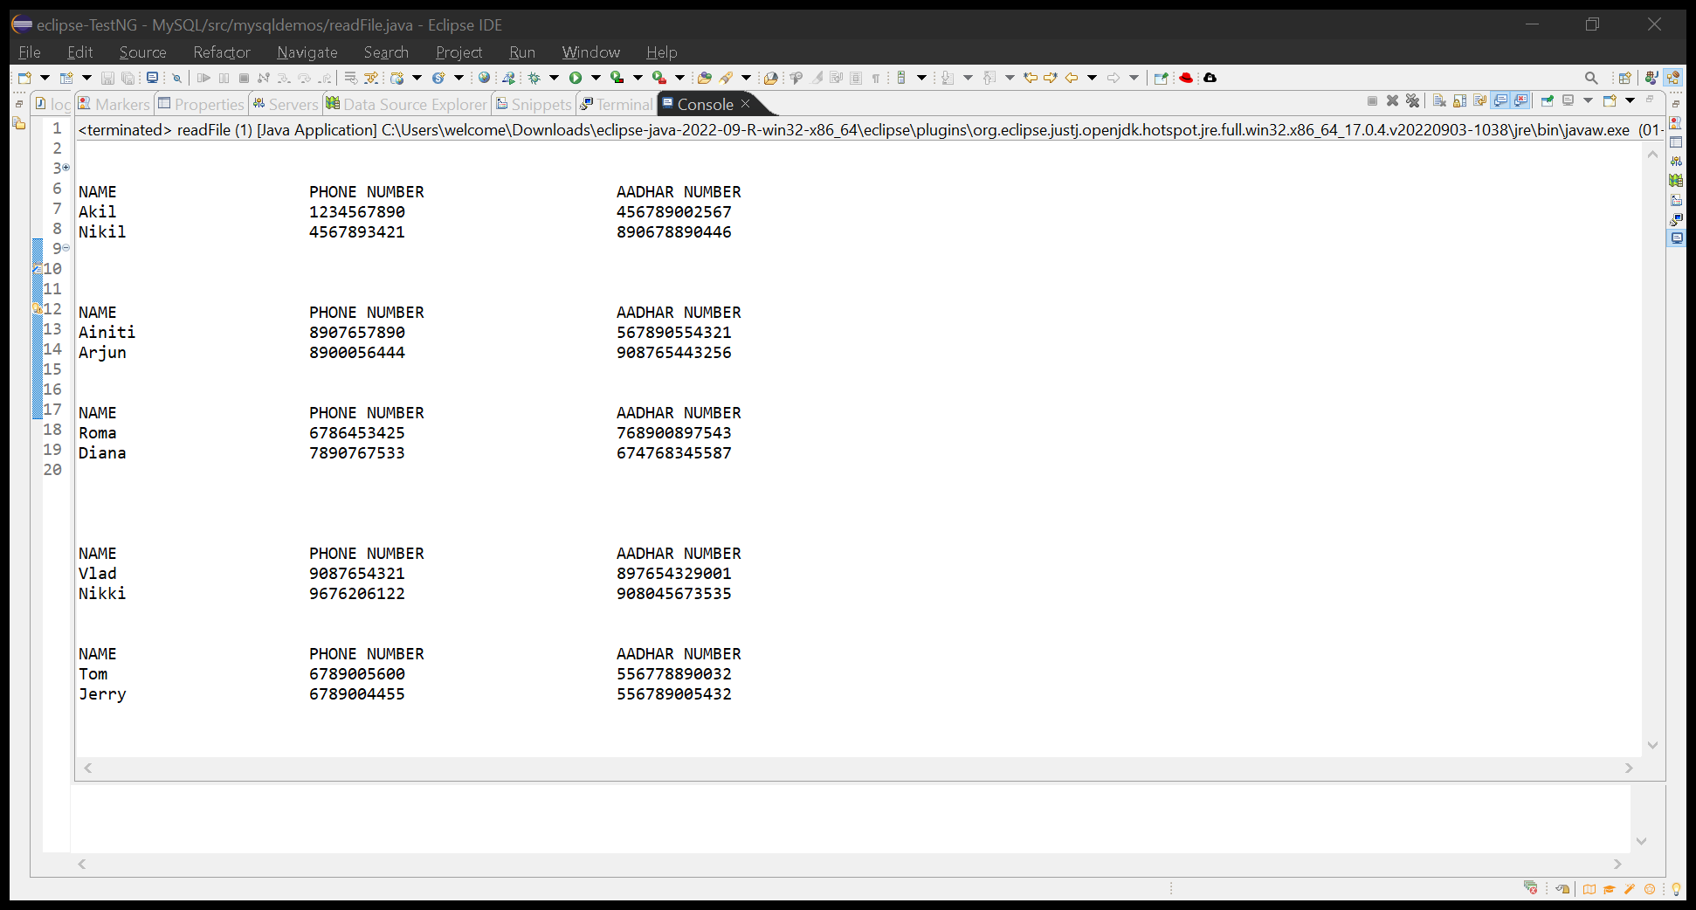
The output of this program is :

Slide 5
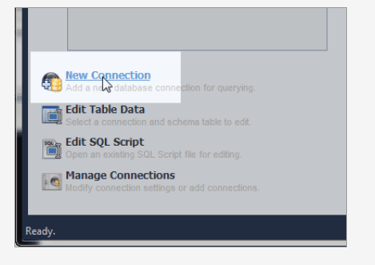
Connect to MYSQL
To connect to MYSQL we need to download MYSQL workbench and download the MYSQL dependencies in eclipse.
After download the workbench we need to create the new database connection.
In the “Set up a New Connection Dialogue” box, Type your Database connection credentials.

Slide 6
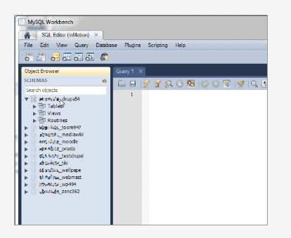
After entering the required data click on test Connection. Then after that type your password and click the “save password in vault” check box. Click ok.
After workbench opens we will see the databases list in the area on the left

Slide 7
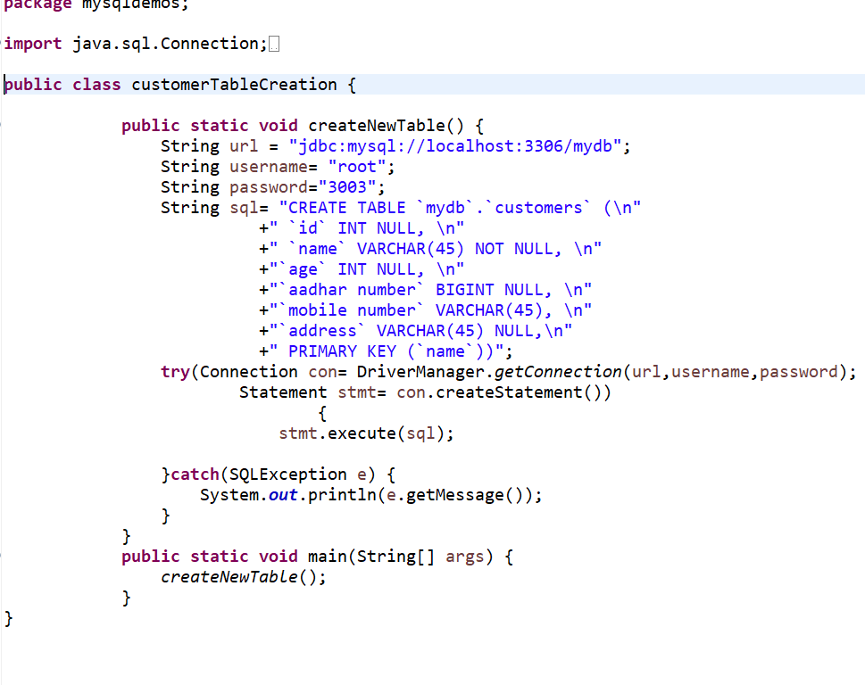
Creating customer table in eclipse java

Slide 8
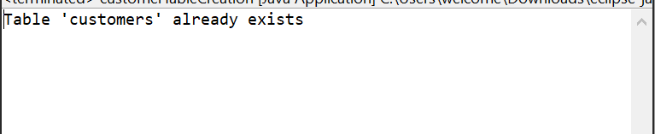
Output for customer table:
Table created automatically when we run the code. If you run the code again then I show the message like this.
If you want to check the table you created go to SQL workbench and check in the schema you already created.
Click on that schema and go to tables and check with the created table name.

Slide 9
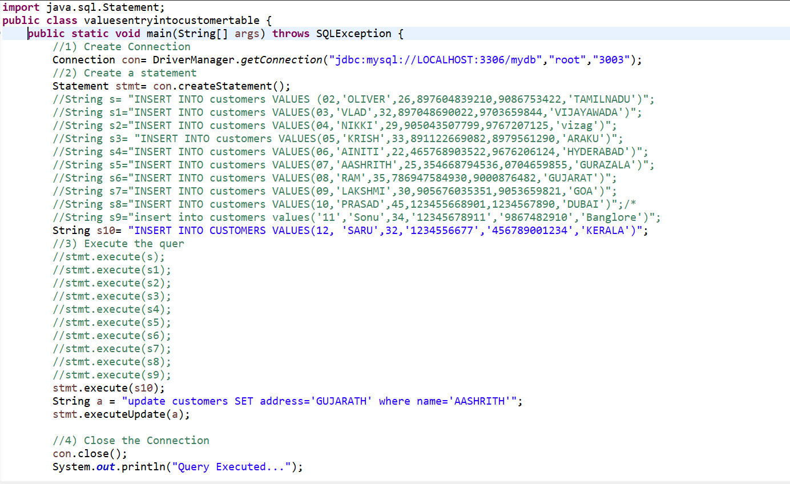
Insert data into customer table:

Slide 10
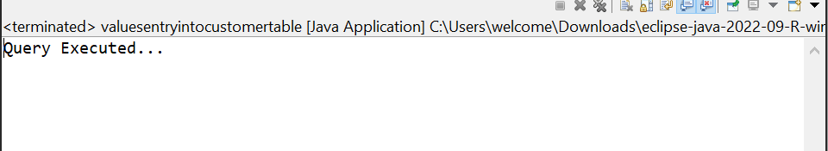
Output for values insertion in customer table:

Slide 11
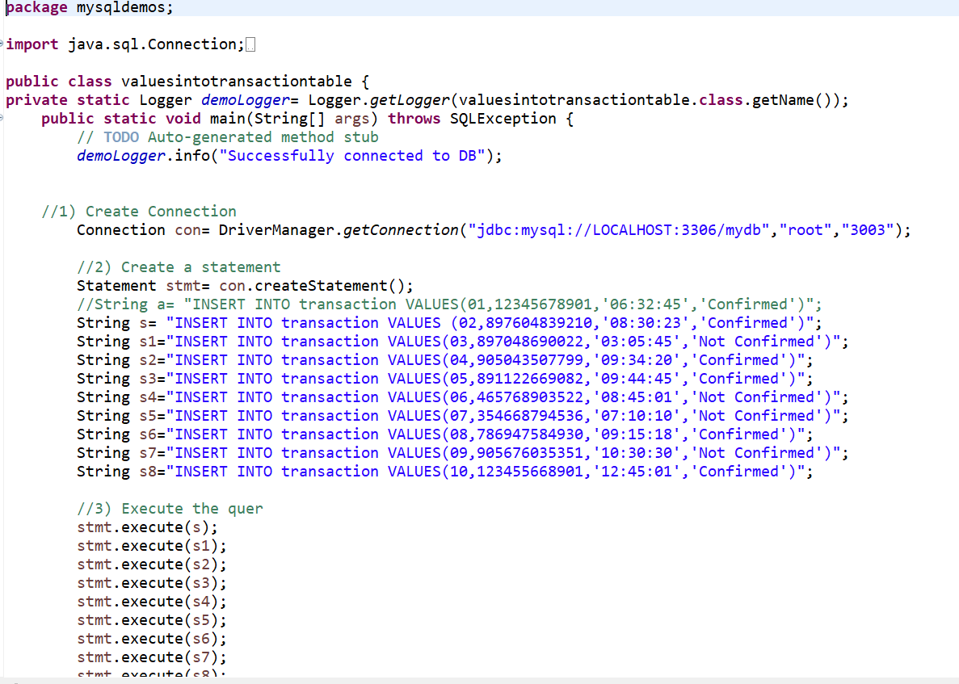
Transaction table creation and values insertion
Creation of Transaction table is same as Customer table creation. After transaction table creation need to insert the values same as customer table values insertion process.

Slide 12
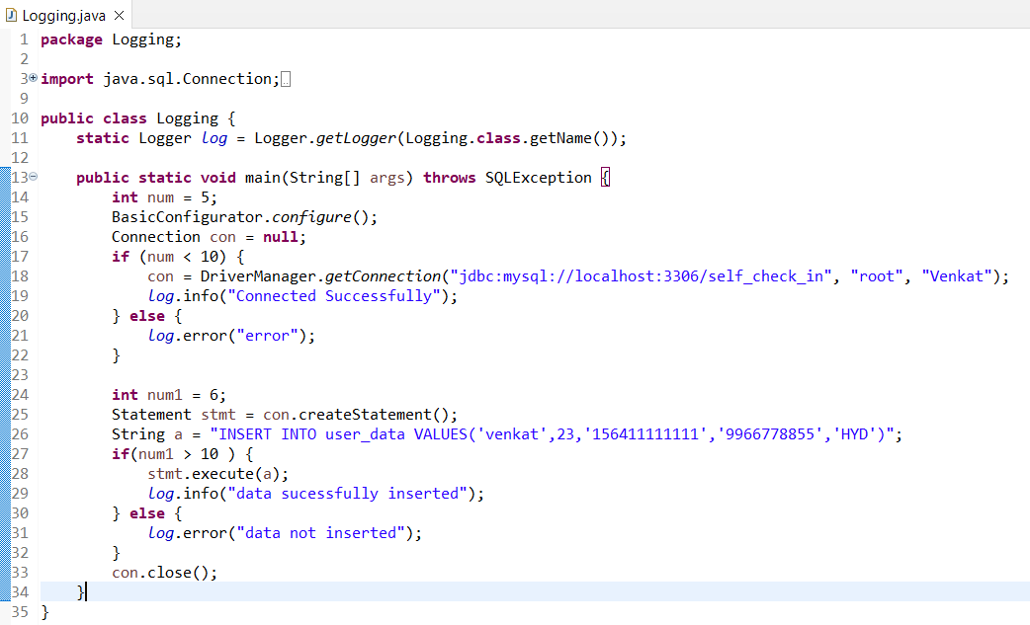
LOG INFORMATION IN THE LOG FILE:

Slide 13
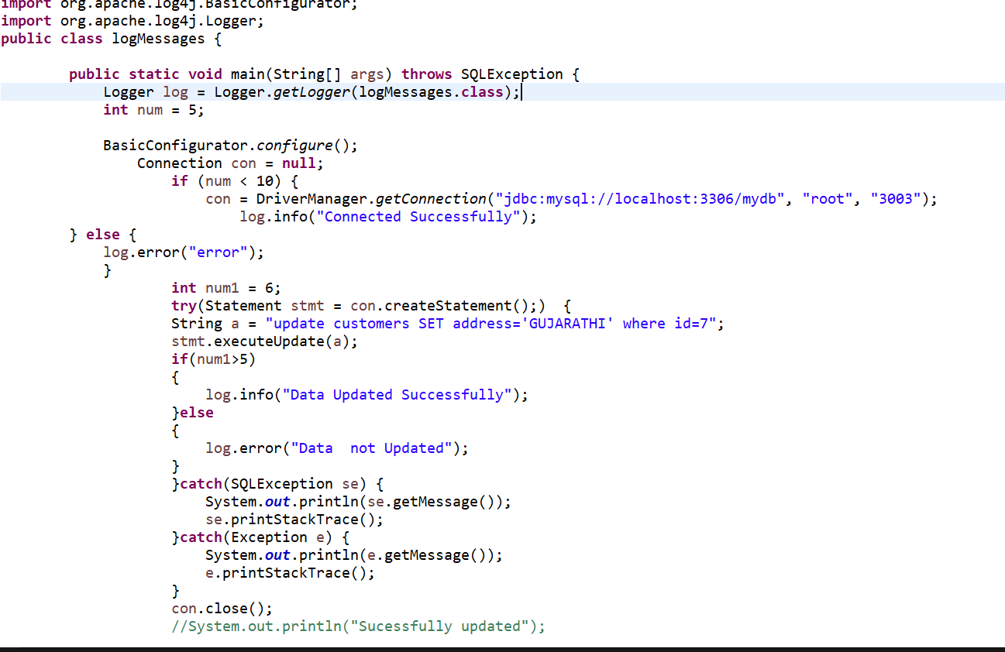
Log messages in logfile using log4j

Slide 14
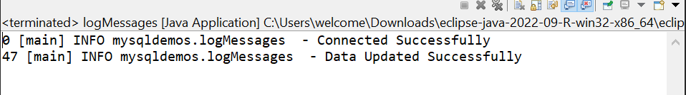
Output for log file

Slide 15
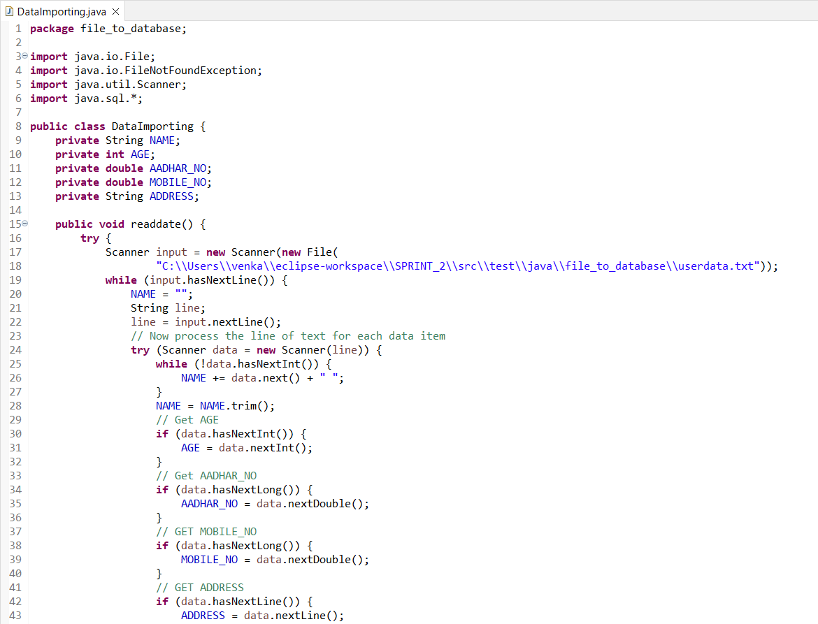
READING DATA FROM THE FLAT FILE & INSERTING IN MYSQL TABLE:

Slide 16
